Slide 1
MATH 1010K Notes – Section 7.6
Polynomials – Overview
Combine Like Terms
Adding and Subtracting Polynomials
The Distributive Property and Multiplying Polynomials
Greatest Common Factor
Factoring Trinomials

Slide 2
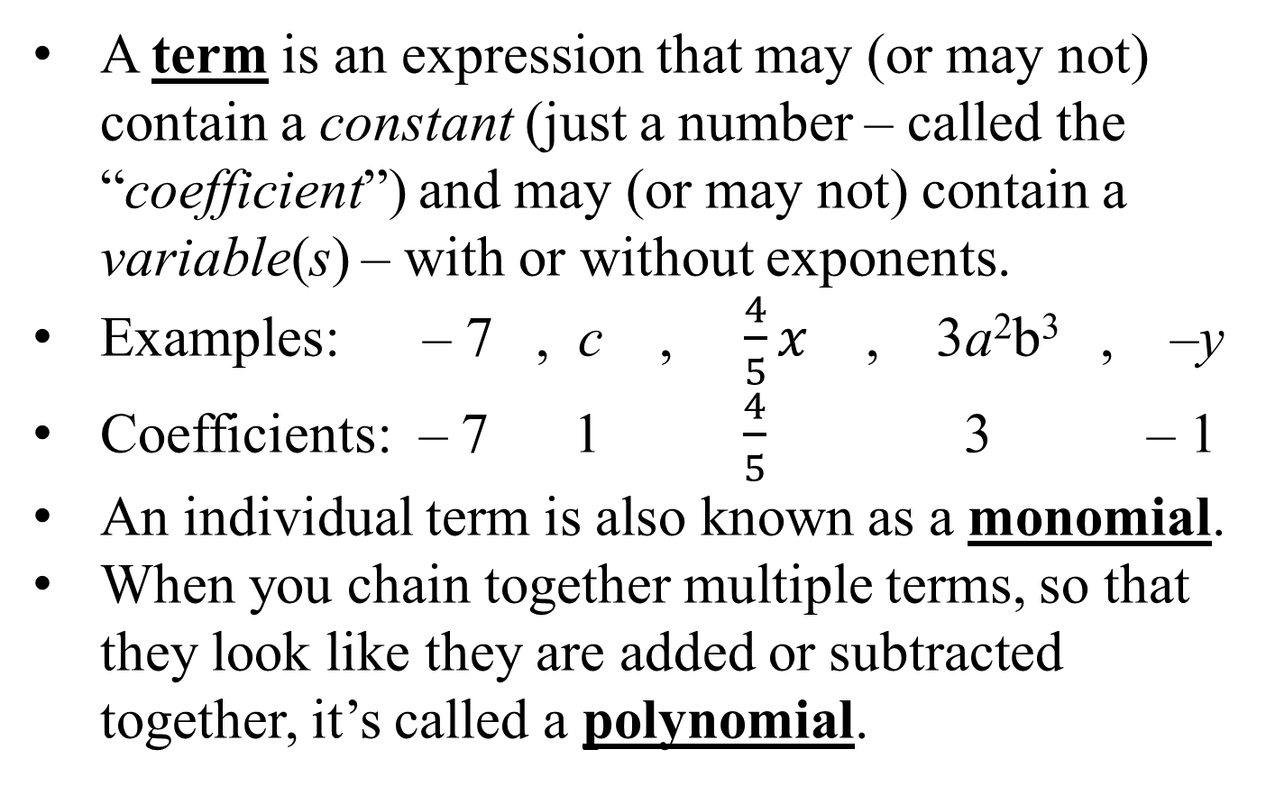
Polynomials
A term is an expression that may (or may not) contain a constant (just a number – called the “coefficient”) and may (or may not) contain a variable(s) – with or without exponents.
Examples: – 7 , c , $\frac{4}{5}x$ , 3a²b³ , –y
Coefficients: – 7 1 $\frac{4}{5}$ 3 – 1
An individual term is also known as a monomial.
When you chain together multiple terms, so that they look like they are added or subtracted together, it’s called a polynomial.

Slide 3
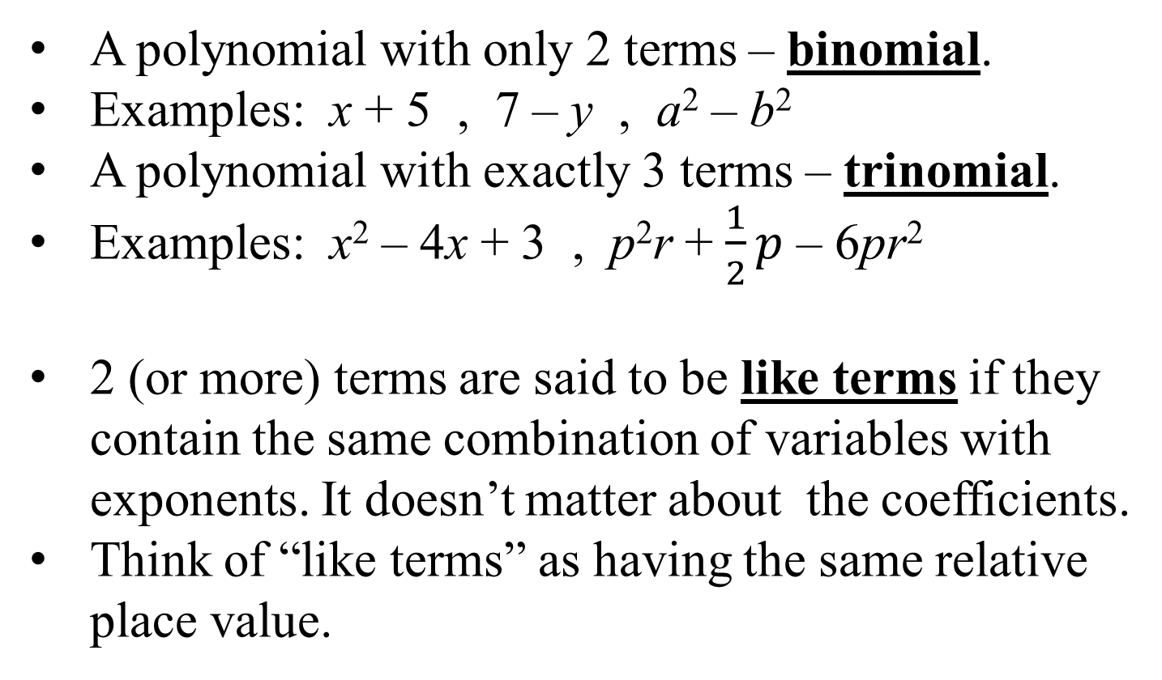
Polynomials
A polynomial with only 2 terms – binomial.
Examples: x + 5 , 7 – y , a² – b²
A polynomial with exactly 3 terms – trinomial.
Examples: x² – 4x + 3 , p²r + $\frac{1}{2}p$ – 6pr²
2 (or more) terms are said to be like terms if they contain the same combination of variables with exponents. It doesn’t matter about the coefficients.
Think of “like terms” as having the same relative place value.

Slide 4
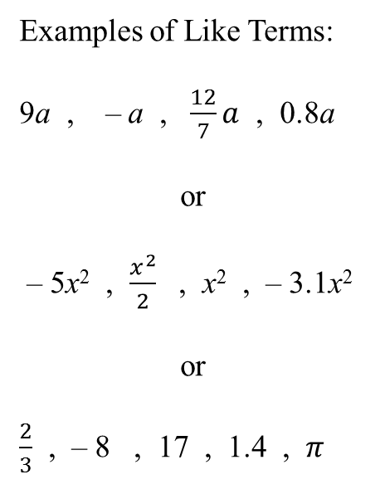
Polynomials and Place Value
Regular arithmetic – “base ten” system
_____ _____ _____ _____
Examples of Like Terms:
9a , – a , $\frac{12}{7}a$ , 0.8a
or
– 5x² , $\frac{x^{2}}{2}$ , x² , – 3.1x²
or
$\frac{2}{3}$ , – 8 , 17 , 1.4 , $π$
thousands
hundreds
tens
ones
Polynomials – any variable is the base
_____ _____ _____ _____
x³
x²
x
constants

Slide 5




Combine (or Collect) Like Terms
To combine (or collect) like terms means to add up the coefficients of those like terms, and keep the same type of variable(s) in the answer.

Slide 6
Add, Subtract, Multiply Polynomials
To add polynomials, simply combine like terms.
To subtract polynomials, convert it to “add the opposite” and then combine like terms.
With subtract, remember: “keep it, change it switch it.”
To multiply polynomials, go term-by-term and first multiply coefficients together and then with the variables, add the exponents together (only if variable is same). Finish by combining like terms, if necessary.

Slide 7
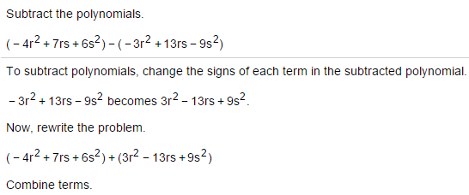
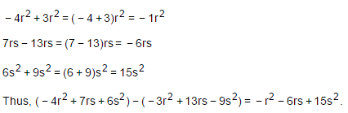
Subtract Polynomials - Example

Slide 8
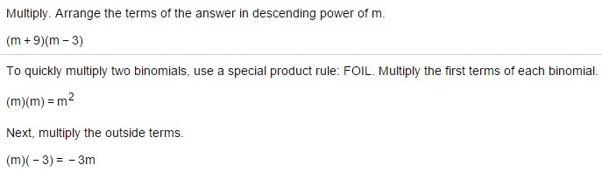

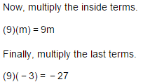
Multiply Polynomials - Example

Slide 9

The Distributive Property
Distributive Property
of Multiplication with
Respect to Addition
a(b + c) = ab + ac
(b + c)a = ba + ca

Slide 10

The Distributive Property

Slide 11
Greatest Common Factor
The greatest common factor (GCF) of a group of natural numbers is the largest number that is a factor of all of the numbers in the group.
The questions in MyMathLab may ask you to use a variety of methods, but we will use 2 methods:
Prime Factorization Method (Factor Tree)
Calculator Method (the gcd command)

Slide 12
Finding the Greatest Common Factor (Prime Factors Method)
Step 1 Write the prime factorization of each number.
Step 2 Choose all primes common to all factorizations, with each prime raised to the least exponent that appears.
Step 3 Form the product of all the numbers in Step 2; this product is the greatest common factor.

Slide 13
Example: Greatest Common Factor by Prime Factors Method (Factor Tree)
Find the greatest common factor of 360 and 1350.
Solution
The prime factorizations are below.
360 = 2³∙3²∙5
1350 = 2∙3³∙5²
So, the GCF is 2∙3²∙5 = 90

Slide 14
Greatest Common Factor – Calculator Method Using the gcd command (greatest common divisor)
A couple of limitations of using the calculator:
1. The gcd command can only do 2 numbers at a time. If more than 2 numbers are involved, the gcd command must be used multiple times, or “nested” – more on that later.
2. The gcd command can only do POSITIVE numbers. If negatives are involved, they must be ignored on the calculator.
3. The gcd command cannot do variables – only numbers (coefficients).

Slide 15

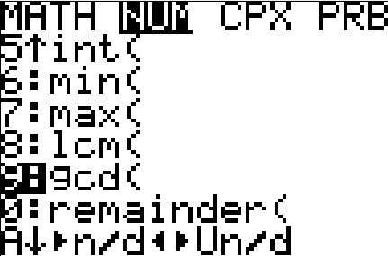

Greatest Common Factor – Calculator Method Using the gcd command (greatest common divisor)
Let’s look at the previous example:
Find the greatest common factor of 360 and 1350.
STEP 2 – It will start out reading just gcd( on the screen.
Enter your first given number, then a comma (over the #7 key), then type your second given number, then type a close-parentheses (above the #9 key), and press ENTER. That’s it!
STEP 1 – Press MATH, the RIGHT arrow (NUM), and scroll to #9, ENTER – or you can just press the #9 button without pressing enter.

Slide 16
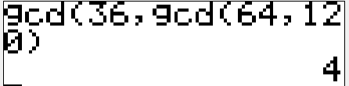
Greatest Common Factor – Calculator Method Using the gcd command (greatest common divisor)
Now let’s look at an example involving 3 numbers.
Find the greatest common factor of 36, 64, and 120.
STEP 2 – It will start out reading just gcd( on the screen.
Type your first given number, then a comma (over the #7 key), then call up the gcd command again (see STEP 1).
Type your second number, then a comma (over the #7 key), then type your third number then type a close-parentheses (above the #9 key), and press ENTER. That’s it!
STEP 1 – Press MATH, the RIGHT arrow (NUM), and scroll to #9, ENTER – or you can just press the #9 button without pressing enter.

Slide 17
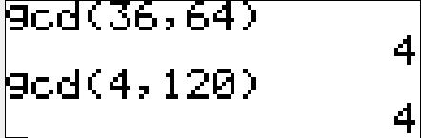
Greatest Common Factor – Calculator Method Using the gcd command (greatest common divisor)
Now let’s look at an example involving 3 numbers.
Find the greatest common factor of 36, 64, and 120. (alternate method)
STEP 2 – The alternate way to do 3 numbers at a time is to do the first 2 numbers, then take that answer and do the gcd command again with that answer and the third number.
STEP 1 – Press MATH, the RIGHT arrow (NUM), and scroll to #9, ENTER – or you can just press the #9 button without pressing enter.

Slide 18
Greatest Common Factor
Factoring Out the GCF
Definition
The greatest common factor (GCF) of two or more terms is the monomial with the largest coefficient and the highest degree that is a factor of all the terms.
A polynomial is said to be prime if the GCF for all its terms is 1.

Slide 19
Factoring Out the GCF
Greatest Common Factor
Example
Factor: 18x⁴ – 30x² .
Solution
1. Find GCF of coefficients. GCF of 18 and 30 is 6.
2. Find GCF of variables. - only if ALL terms have the same variable. Pick the variable with smallest exponent. Pick the “runt,” or the “baby.” Repeat the process for however many variables are present.
GCF of x⁴ and x² is x² .
3. Multiply coefficient and variable GCF’s together. The final overall GCF is 6∙x², or simply 6x² .

Slide 20
Factoring Out the GCF
Greatest Common Factor
Example
Factor: 18x⁴ – 30x² .
6x² ( )
Solution
4. Write the GCF (from Step 3) on the next line underneath your given expression to factor, and open up a set of parentheses the same width as your given expression.
5. To fill inside the parentheses, use the GCF and ask “times-what, equals my starting amount?” Do coefficients (numbers) first, followed by variables. (see continued example, next slide).

Slide 21
Factoring Out the GCF
Greatest Common Factor
Example
Factor: 18x⁴ – 30x² .
6x² ( )
Solution
18x⁴ – 30x²
6x² ( 3x² – 5 )

Slide 22



Factoring Out the GCF
Factoring Out a Common Factor
Example
Factor
1. 10x² – 15x 2. 8x³ + 20x²
1.
2.
Not completely factored:
Solution

Slide 23
Factoring Trinomials of the
Form x² + bx + c ;
and Difference of Two Squares

Slide 24
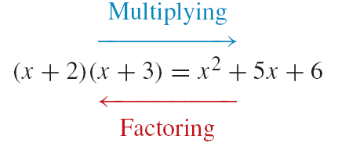
Multiplying Polynomials Versus Factoring Polynomials
Multiplying and factoring are reverse processes,
For example

Slide 25
Shall We Play a Game?
Find two numbers that multiply to make 6 but also add to make 5.
Find two numbers whose product is 24 and whose sum is 10.
Find two numbers that multiply to make 36 but also add to make –15 .
Find two numbers whose product is 48 and whose sum is –19.

Slide 26
Shall We Play a Game?
Find two numbers that multiply to make –6 but also add to make 5.
Find two numbers whose product is –24 and whose sum is 10.
Find two numbers that multiply to make –36 but also add to make –9.
Find two numbers whose product is –48 and whose sum is –13.

Slide 27
Factoring a Trinomial
Factoring x² + b+ c
Process
To factor x² +bx +c, look for two integers p and q whose product is c and whose sum is b. That is, pq = c and p + q = b. If such integers exist, the factored polynomial is
(x + p)(x + q)

Slide 28
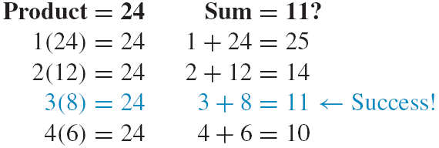

Factoring a Trinomial – Positive Constant Term c
Factoring a Trinomial of the Form x² + b+ c
Example
Factor x² + 11x + 24.
We need two integers whose product is 24 and whose sum is 11
3(8) = 24 and 3 + 8 = 11: last terms are 3 and 8
Check:
Solution

Slide 29
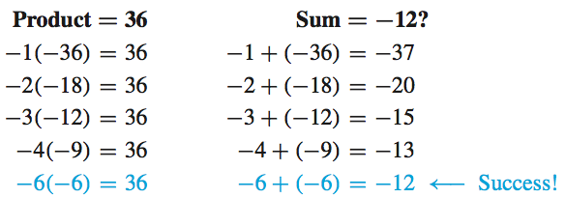
Factoring a Trinomial – Positive Constant Term c
Factoring a Trinomial of the Form x² + b+ c
Example
Factor x² – 12x + 36.
x² – 12x + 36 = (x – 6)(x – 6) = (x – 6)²
Solution

Slide 30
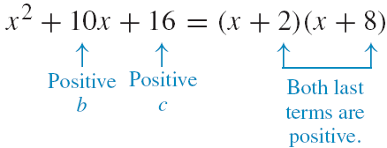
Factoring a Trinomial – Positive Constant Term c
Factoring a Trinomial of the Form x² + b+ c
Process
To factor a trinomial of the form x² + bx + c with a
positive constant term c,
If b is positive (middle term), look for two positive integers whose product is c and whose sum is b.

Slide 31
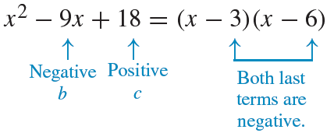
Factoring a Trinomial – Positive Constant Term c
Factoring a Trinomial of the Form x² + b+ c
Process
If b is negative (middle term), look for two negative integers whose product is c and whose sum is b.

Slide 32
I feel a song coming on…
(To the tune of “If You’re Happy and You Know It”)
If the last term is positive, they’re the SAME.
You look to the middle for the charge (sign).
If it’s positive, “plus…plus” ( __ + __ ) ( __ + __ )
If it’s negative, “minus…minus” ( __ – __ ) ( __ – __ )
If the last term is positive, they’re the SAME.

Slide 33
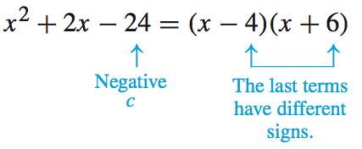
Factoring with c Negative
Factoring a Trinomial of the Form x² + b+ c
Process
To factor a trinomial of the form x² + bx + c with a negative constant term c, look for two integers with different signs whose product is c and whose sum is b. For example,
If the last term is negative, they’re DIFFERENT “One of each” ( __ – __ ) ( __ + __ ) or switched.

Slide 34
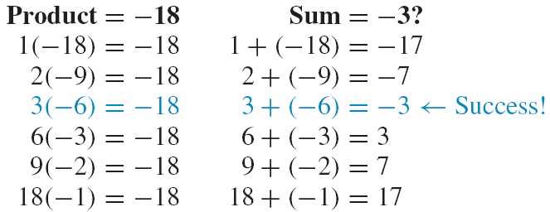

Trinomials with Negative Constant Terms
Factoring a Trinomial of the Form x² + b+ c
Example
Factor w² – 3w – 18.
Check:
Solution

Slide 35
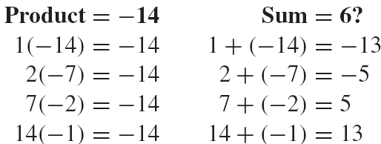
Prime Polynomials
Definition
Definition
A polynomial that cannot be factored is called prime.
None of the sums equal 6. Thus, prime.
Example
Factor –14 + 6x + x².
Solution

Slide 36
Difference of Two Squares
The Difference of Two Squares
A² − B² = (A + B)(A − B)
In words: The difference of the squares of two terms is the product of the sum of the terms and the difference of the terms.
Property

Slide 37
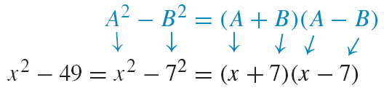
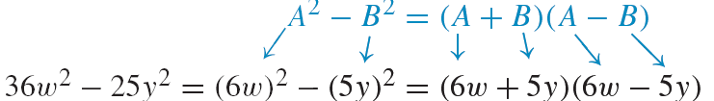
The Difference of Two Squares
Difference of Two Squares
Example
Factor.
1. x² – 49
Since x² − 49 = (x)² − (7)², we substitute x for A and 7 for B:
36w² – 25y²
Since 36w² − 25y² = (6w)² − (5y)², we substitute 6w for A and 5y for B:

